Slide 1
STAT 456 Final Project
Sri Medicherla, Michelle Harris, Hailey Lee

Slide 2


Business Problem
Which variables significantly predict the price of a car?
How well do these variables explain car prices?

Slide 3

Proposed Solution
Conduct Exploratory Data Analysis (EDA)
Split dataset into training and testing
Investigate each variable's effect on price through modeling
Determine which model is the strongest through testing each model

Slide 4
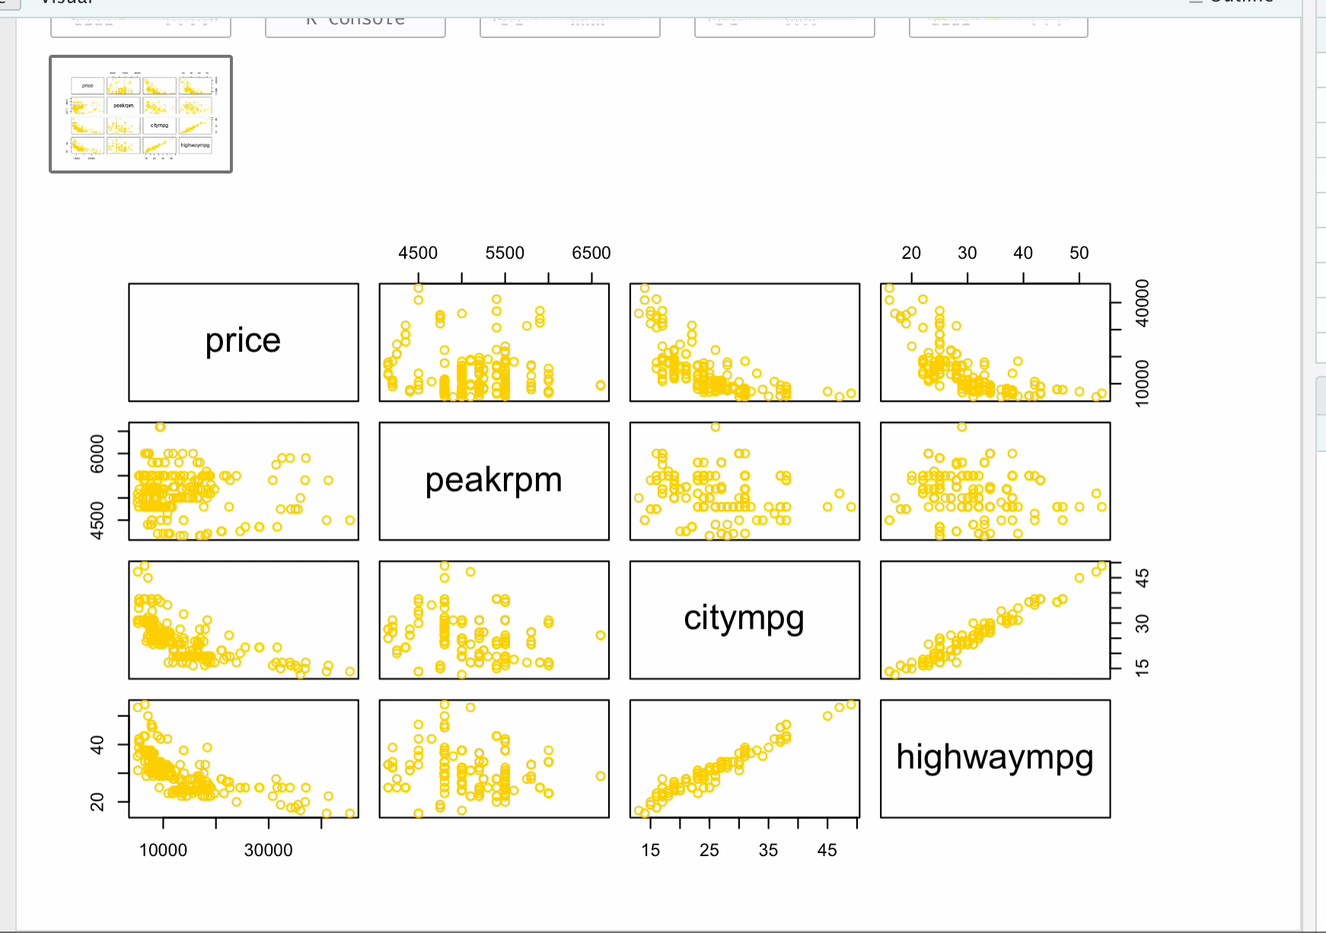
EDA
Exploratory plots: variable relationships with price

Slide 5
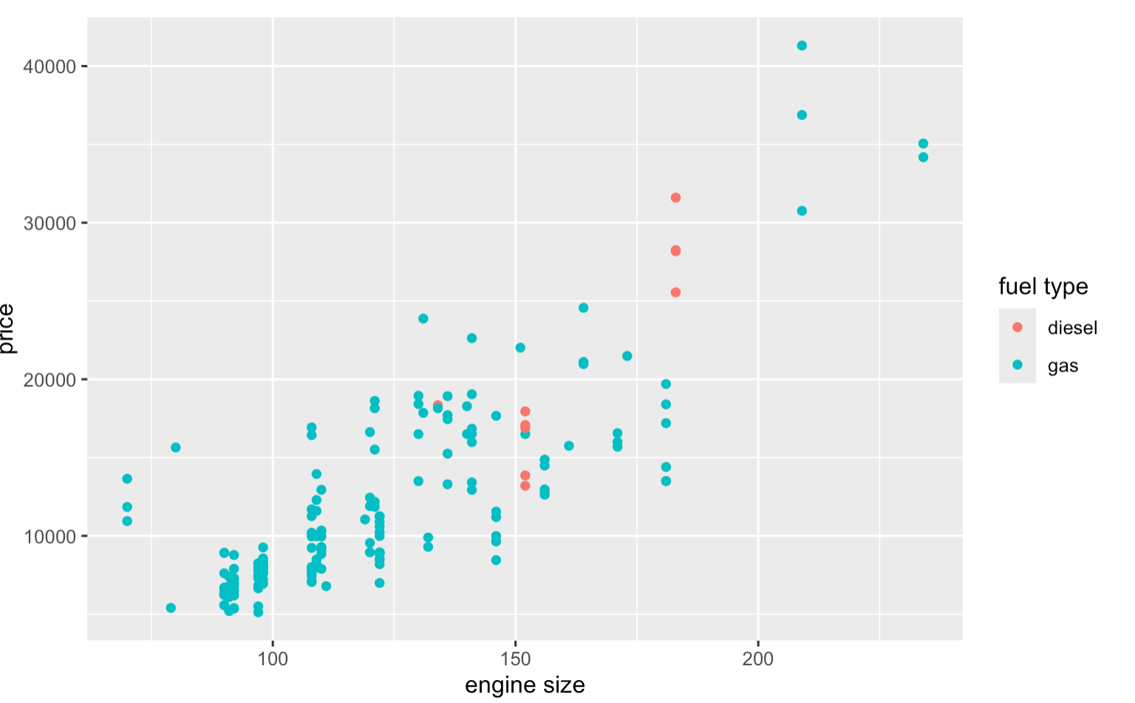
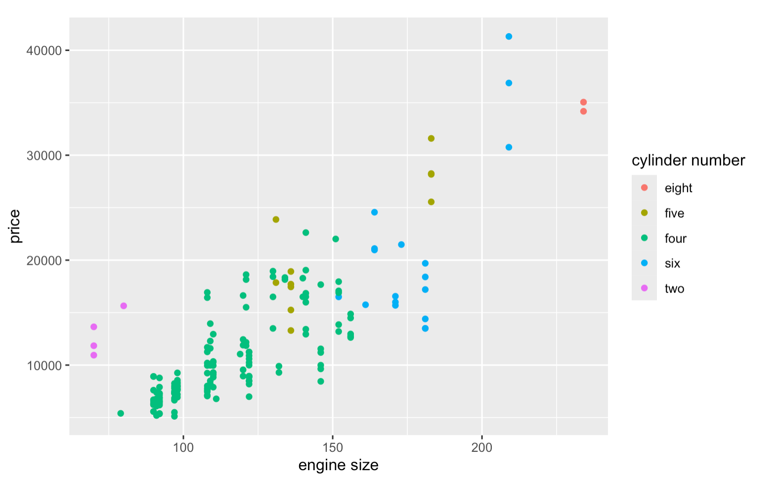
EDA COntd...
Plot of engine size vs. Price colored by fuel type
Plot of engine size vs. Price colored by number of cylinders

Slide 6
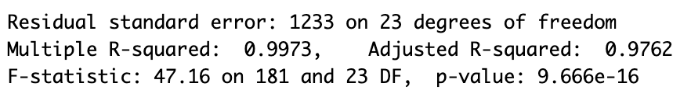
multiple linear regression (MLR): MODEL 1
Started with linear model with ALL variables
Adjusted R^2 value: 0.9762
P-value: 9.666e-16

Slide 7
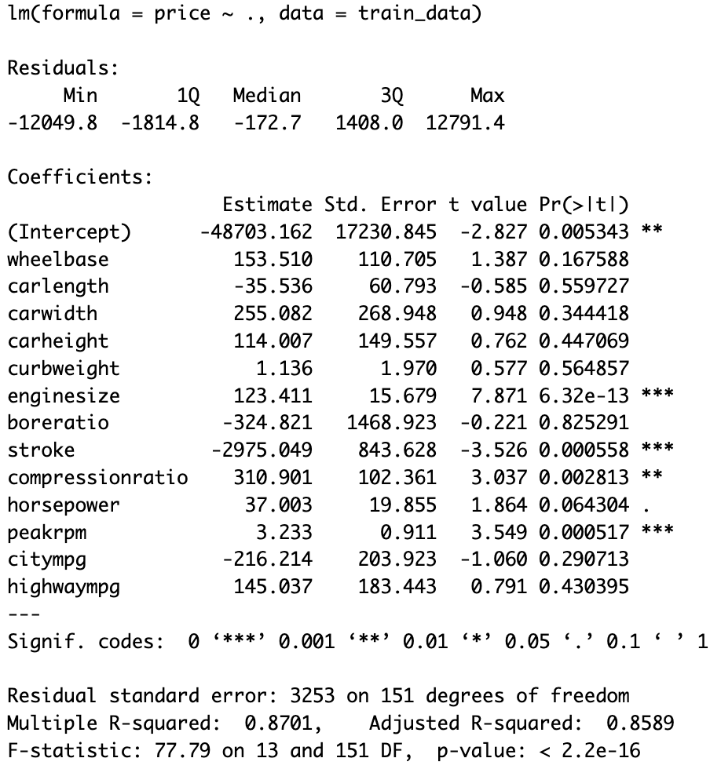
MLR MODEL 2
Next, model with only continuous variables
Adjusted R^2 value: 0.8589
RMSE: 3224.741
P-value: 2.2e-16

Slide 8
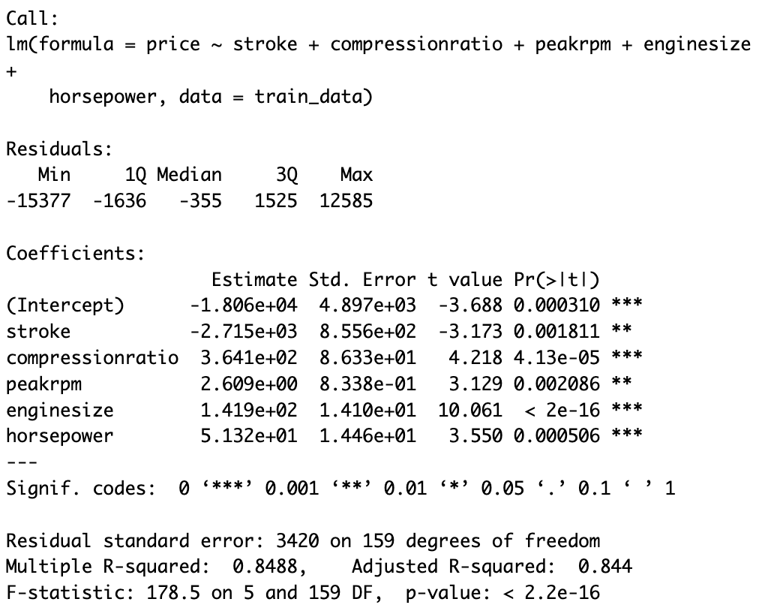
Mlr model 3
Model with significant codes variables
Adjusted R^2 Value: 0.844
RMSE: 3353.8
P-value: 2.2e-16

Slide 9

Stepwise regression
METHODS:
Forward
Backward
Bidirectional
Notes:
-forward
-backward
-bidirectional: model we are using; combination of forward and backward

Slide 10
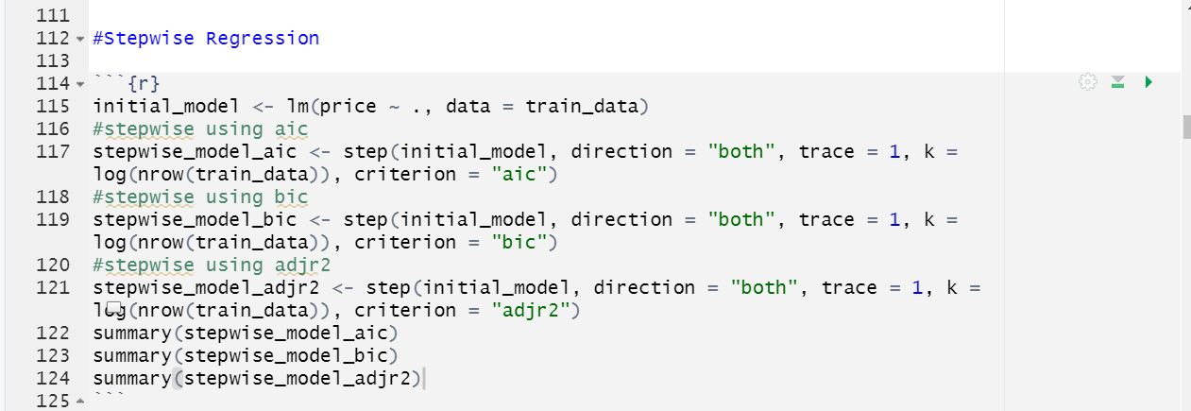
Stepwise regression code using AIC, BIC, and adjr2 as the criterion
Notes:
Note that direction = 'both' for all models since this is bidirectional stepwise regression
Criterion changes for each model: 'aic', 'bic', and 'adjr2'
Using train data

Slide 11
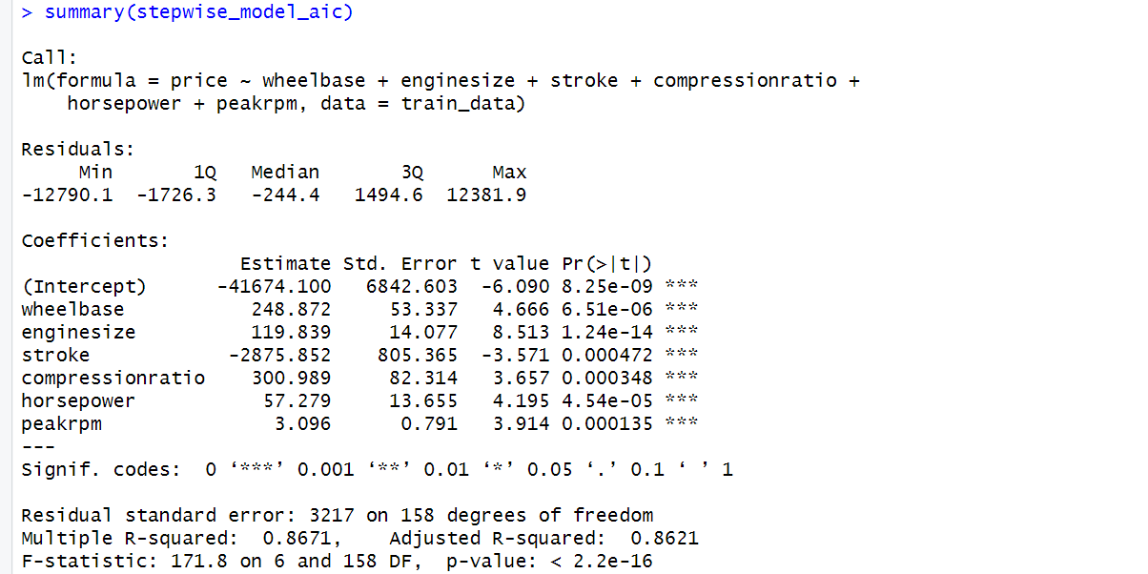
P-value: nearly 0
Adjusted R^2: .8621
Notes:
Stepwise model using aic
P-value is very very small
Adjr2 is .8621, indicates that approximately 86.21% of the variability in the price of cars is explained by the variables included in the model

Slide 12
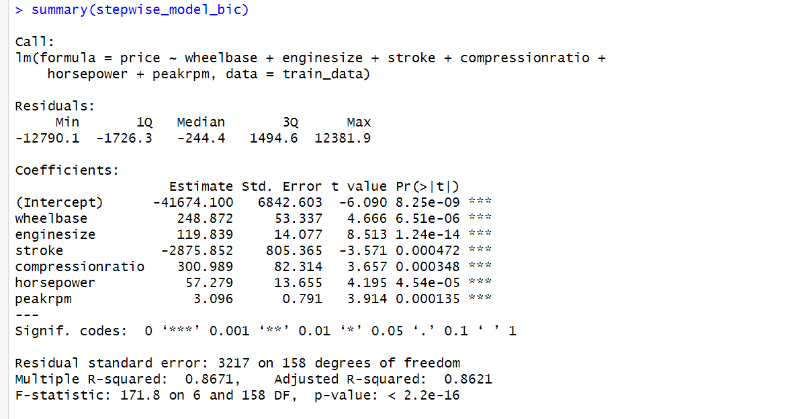
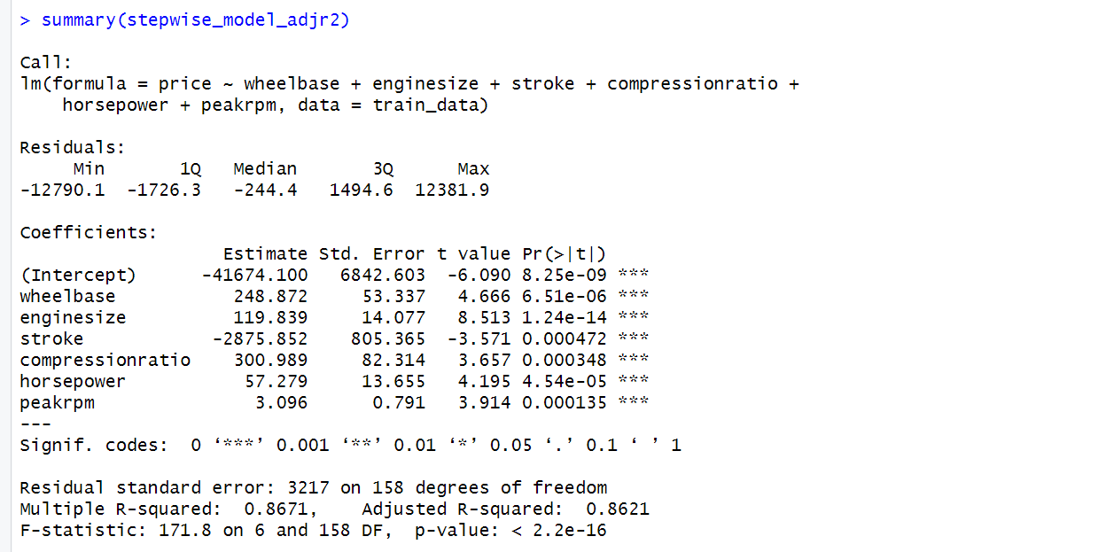
Notice that the p-values and adjusted R^2 using the 'BIC' and 'adjr2' criterion are the same as using the 'AIC' criterion.
Notes:
Top is using bic, bottom is using adjr2. Both give a near-zero p-value and adjr2 of .8621
These numbers should have changed with each criterion. Why didn't it?

Slide 13
Let's explore why that may happen...
Small dataset
Overfitting
Correlated predictors
Notes:
-Small dataset: if the number of observations relative to the number of variables is small, stepwise selection may not have enough information to differentiate between the criteria accurately.
-Overfitting: with smaller data sets, stepwise selection can lead to overfitting. If the model is overfitting, then stepwise selection may select the same variables for different criterion.
-Correlated predictors: if some predictor variables are highly correlated, they convey the same information about the response variable. If these predictor variables are included in the model, stepwise selection may choose these correlated variables since the criterion does not penalize correlated variables.

Slide 14
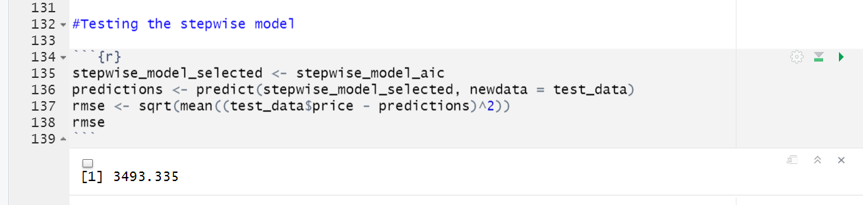
Testing the model
RMSE: 3493.335
RMSE is a little high... maybe outliers?
Notes:
-testing the model using the aic model since aic, bic, and adjr2 models were all the same
Notice we are using test data here
Note the rmse here is 3493.335. Could be considered high because the model's predictions deviate from the actual car prices by approximately $3493. Let's see if we can get the number down

Slide 15
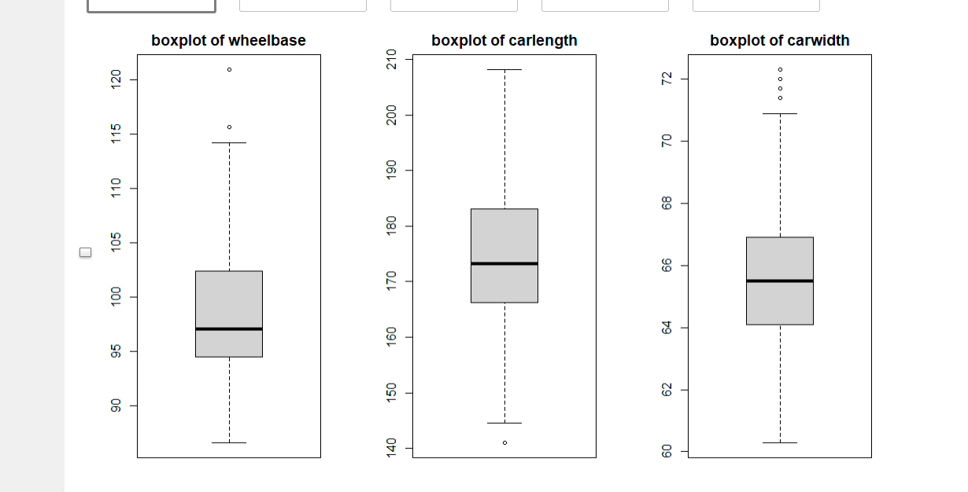
Exploring outliers and removing them
Boxplots of original continuous variables
Notes:
Notice the outliers on wheelbase, carlength, carwidth, enginesize, stroke, compressionratio, horsepower, peakrpm, citympg, and highwaympg.

Slide 16
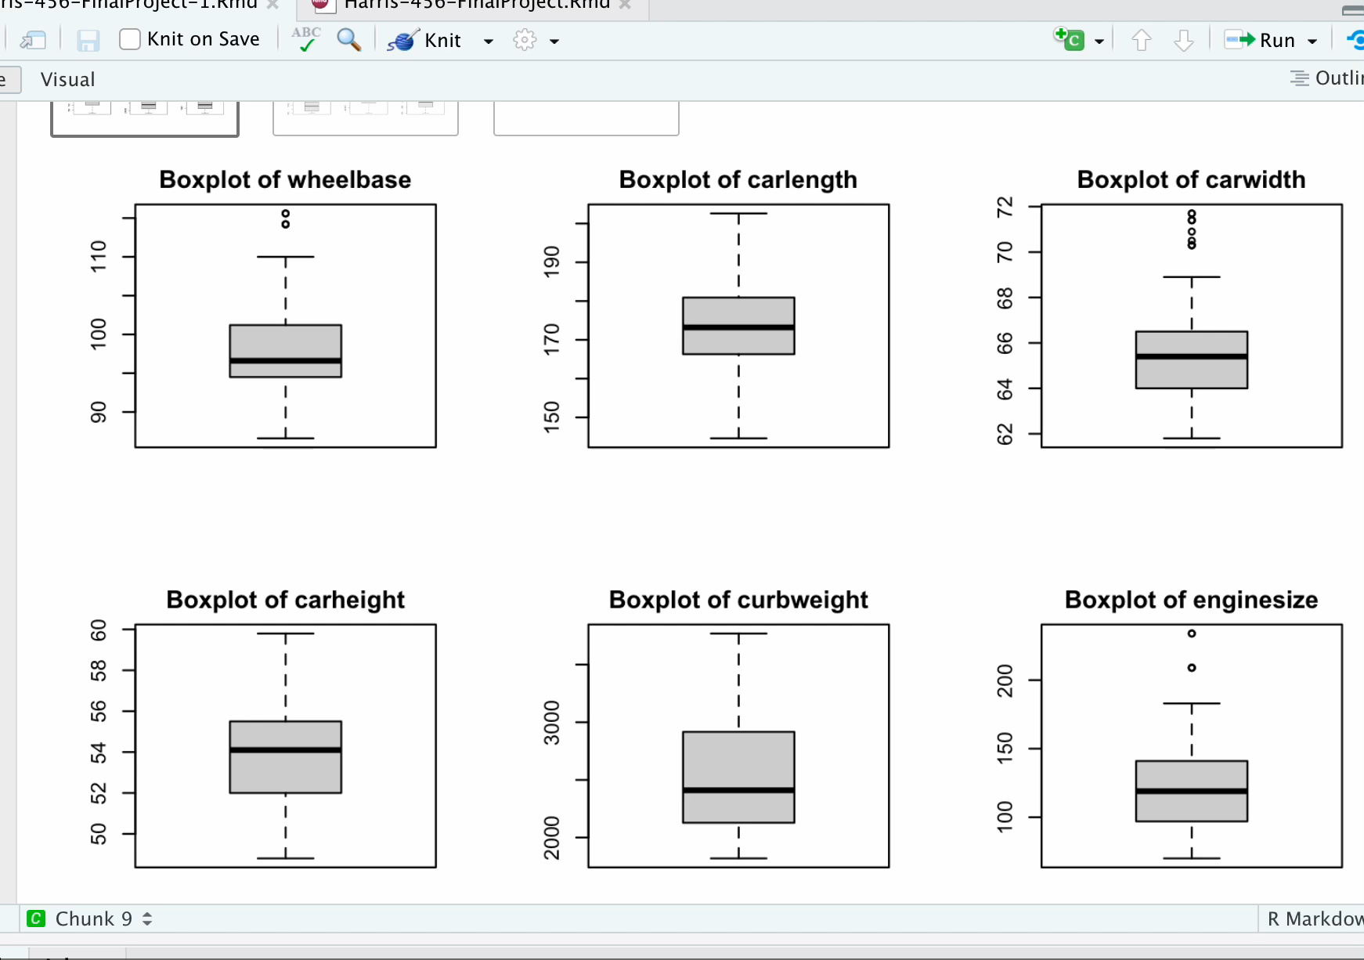
Investigation: Removing Outliers?
RMSE before: 3493.335
RMSE after: 6028.778
Notes:
Using R, we can set a threshold that checks if the data points are above or below it. If they are above, we can consider them an outlier. For the purposes of trying to reduce our RMSE, lets remove the outliers and retest our model using the cleaned data.
*during vid -> here we can see the boxplots of the cleaned data. Notice that we can see some of the outliers have been removed
Since we removed some observations, we needed to reconfigure our training and testing data to represent the new number of observations. After we did that, we re ran the code to give us the new rmse. New rmse is 6028.778. Removing outliers actually significantly increased rmse and made the model worse. The p-value is still very small, but the adjr2 is now .8282.

Slide 17
Stepwise Regression model vs linear regression model
STEPWISE MODEL (before removing outliers)
Price = -41674.100 + 248.872 * wheelbase + 119.839 * enginesize – 2875.852 * stroke + 300.989 * compressionratio + 57.279 * horsepower + 3.096 * peakrpm
MLR MODEL 2: (BEST)
Price = -48703.162 + 153.510 * wheelbase – 35.536 * carlength + 255.082 * carwidth + 114.007 * carheight + 1.136 * curbweight + 123.411 * enginesize – 324.821 * boreratio –2975.049 * stroke + 310.901 * compressionratio + 37.003 * horsepower – 3.233 * peakrpm – 216.214 * citympg + 145.037 * highwaympg

Slide 18

Findings and Conclusions
Which variables are most significant?
Enginesize
Stroke
Compressionratio
Peakrp
Notes:
Note that the variables mentioned above are the *most* statistically significant ones, but wheelbase, carlength, carwidth, carheight, curbweight, boreratio, horsepower, citympg, and highwaympg also contribute
How well do these variables explain car prices? 85.89% of variability in price is explained by these variables. (adjr2 from mlr model 2)

